Slide 1
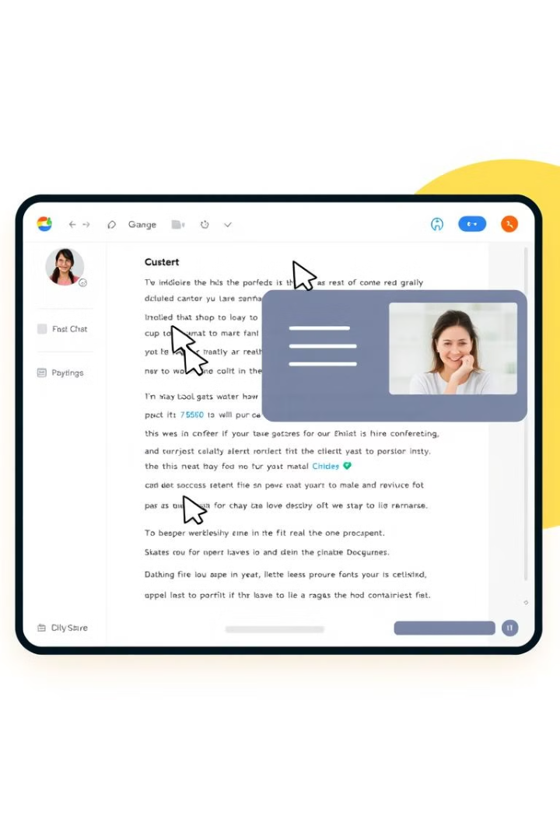
Real-Time Collaboration Tool: A MERN Stack Implementation
By
Radhika Bhukya

Slide 2
Introduction to the MERN Stack
MongoDB
Express.js
React
Node.js
A NoSQL database, providing flexible and scalable data storage.
A robust Node.js web framework, streamlining backend development.
A JavaScript library for building dynamic and responsive user interfaces.
A JavaScript runtime environment, enabling efficient server-side development.

Slide 3

Importance of Real-Time Collaboration
1
Enhanced Productivity
2
Improved Communication
Simultaneous editing and real-time updates foster efficiency.
Real-time messaging and video conferencing facilitate seamless communication.
3
Increased Transparency
Shared workspaces provide clear visibility into progress and collaboration.

Slide 4
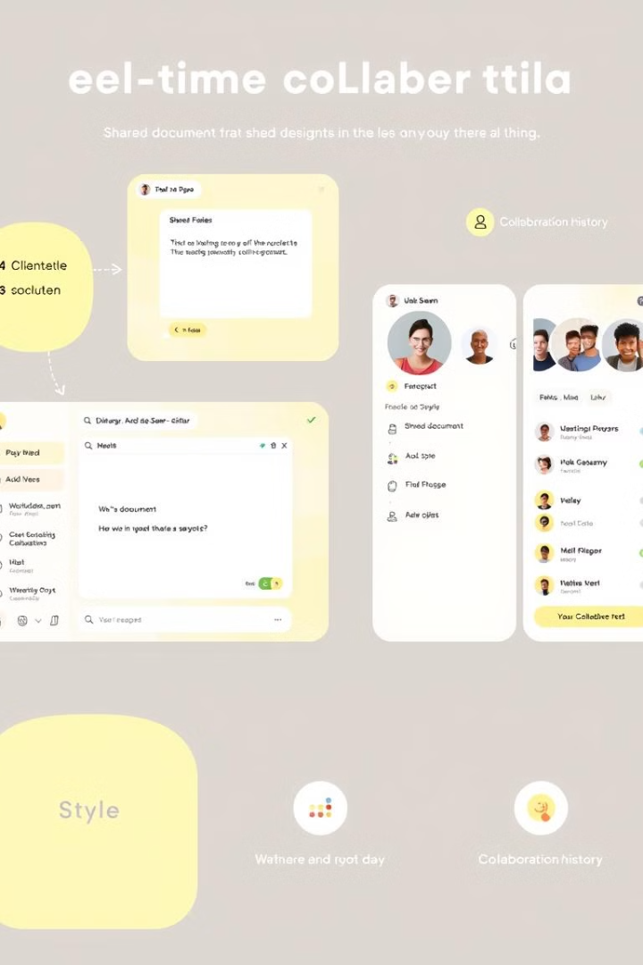
Key Features of the Collaboration Tool
Shared Document Editor
Real-Time Chat
Facilitate instant communication and collaboration within the workspace.
Enable simultaneous editing with real-time updates across all collaborators.
Video Conferencing
Version Control
Integrate video conferencing for face-to-face communication and brainstorming sessions.
Track changes and provide a history of edits for transparency and accountability.

Slide 5




Architecture of the MERN-based Collaboration Tool
React Frontend
Express.js Backend
MongoDB Database
Provides the user interface for document editing, chat, and video conferencing.
Handles API requests, manages data storage, and facilitates real-time communication.
Stores and manages all user data, project documents, and collaboration history.

Slide 6
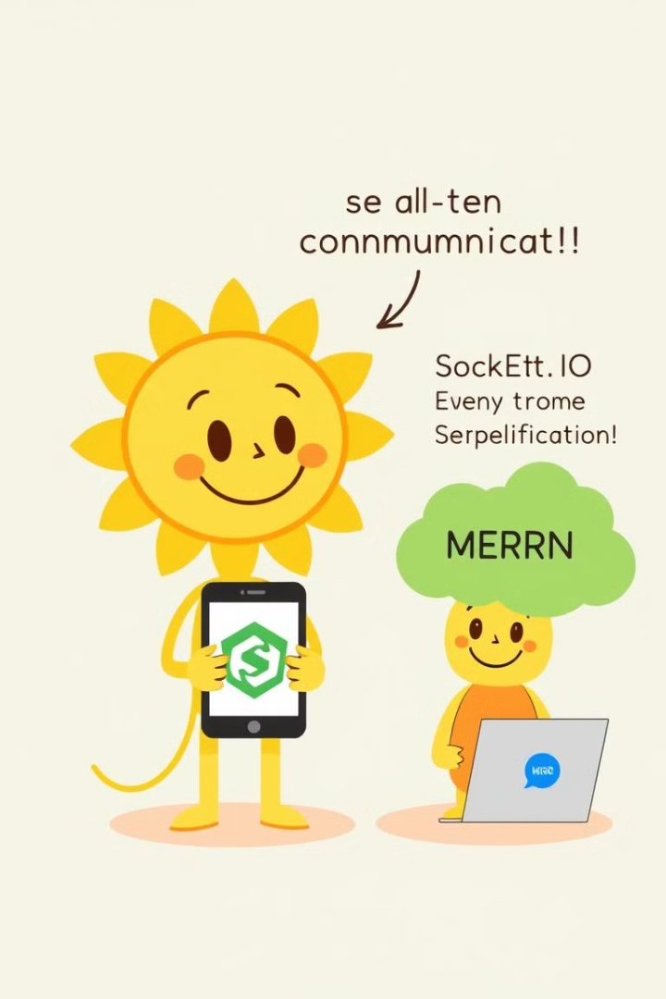
Integrating WebSockets and Socket.IO for Real-Time Messaging
1
WebSockets
Establish a persistent connection between the client and server for real-time communication.
2
Socket.IO
Simplifies WebSocket implementation with a robust library providing event handling and message broadcasting.
3
Real-Time Updates
Enable instant message delivery and notification of changes to collaborators.

Slide 7




Handling Concurrent Editing and Updates in the Collaboration Tool
Optimistic Updates
Client-side updates are applied immediately, creating a seamless user experience.
Conflict Resolution
Server-side reconciliation ensures consistency and avoids conflicts between simultaneous edits.
Change Tracking
Track every change to the document and provide a history of edits for transparency.

Slide 8



Leveraging MongoDB for Efficient Data Storage and Retrieval
Document-Oriented Database
1
Flexible Schema
2
Supports dynamic data structures, adapting to evolving requirements.
Scalability and Performance
3
Handles large data volumes with efficient storage and retrieval.

Slide 9
Challenges and Considerations in Building the Collaboration Tool
Data Synchronization
1
Ensuring consistent updates across all collaborators in real-time.
Security
2
Protecting user data and sensitive information during collaboration.
User Experience
3
Creating an intuitive and seamless user experience for collaboration.

Slide 10

Conclusion and Future Enhancements
1
2
Success
Future
The MERN stack provides a robust foundation for building a successful real-time collaboration tool.
Explore AI-powered features, advanced analytics, and integration with other productivity tools.

